Slide 1
def mushroom_classification(): author = 'Cloe Kwiatkowski'
Milestone3.ipynb
visualizations.ipynb
Python 3.10.9
Cell 1 of 14

Slide 2
for content in table_of_contents: print(content)
Milestone3.ipynb
visualizations.ipynb
... research_question
key_takeaways
mushrooms.csv
model
evaluation
results
conclusion
Python 3.10.9
Cell 2 of 14

Slide 3
# “This dataset describes mushrooms in terms of their physical characteristics. They are classified into: poisonous or edible.” # “This dataset includes descriptions of hypothetical samples corresponding to 23 speciesof gilled mushrooms in the Agaricus and Lepiota Family. Each species is identified as definitely edible, definitely poisonous, or of unknown edibility and not recommended. This latter class was combined with the poisonous one. The Guide clearly states that there is no simple rule for determining the edibility of a mushroom; no rule like leaflets three, let it be'' for Poisonous Oak and Ivy.”
Milestone3.ipynb
visualizations.ipynb
research_question = ‘How can we use machine learning to select the most important features for determining if a mushroom is edible or poisonous? Are there certain features that are considered most important across classification models?’
Python 3.10.9
Cell 3 of 14

Slide 4
1: 'There are several ML models that can produce accurate mushroom classification’, 2: 'Decision tree models are most accurate’, 3: 'Some features are more important in classification’
Milestone3.ipynb
visualizations.ipynb
key_takeaways = {
}
Python 3.10.9
Cell 4 of 14

Slide 5
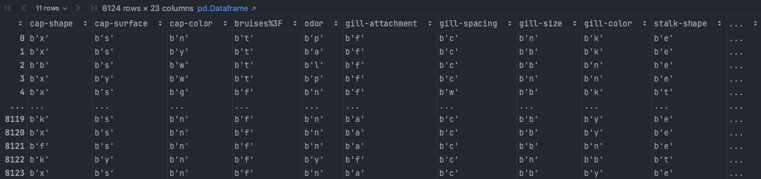
# importing pandas import pandas as pd # importing data mushrooms = pd.read_csv('mushroom_clean.csv') mushrooms.head()
Milestone3.ipynb
visualizations.ipynb
Python 3.10.9
Cell 5 of 14

Slide 6
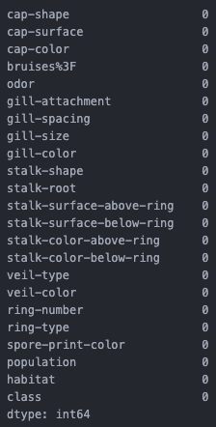


# features of interest X = mushrooms.drop(['class'], axis=1) # target vector y = mushrooms['class'] # 0 == edible; 1 == poisonous # imports from sklearn.preprocessing import LabelEncoder le = LabelEncoder() for i in columns: mushrooms[i] = le.fit_transform(mushrooms[i]) # checking for N/A values mushrooms.isna().sum()
Milestone3.ipynb
visualizations.ipynb
Python 3.10.9
Cell 6 of 14

Slide 7
Model #1 # building a decision tree classifier that splits based on entropy entropy_tree = DecisionTreeClassifier(criterion='entropy', random_state=42) # fitting model to the training data entropy_tree.fit(X_train, y_train) Model #2 # building a decision tree classifier that splits based on gini index gini_tree = DecisionTreeClassifier(criterion='gini', random_state=42) # fitting model to the training data gini_tree.fit(X_train, y_train)
Milestone3.ipynb
visualizations.ipynb
Python 3.10.9
Cell 7 of 14

Slide 8
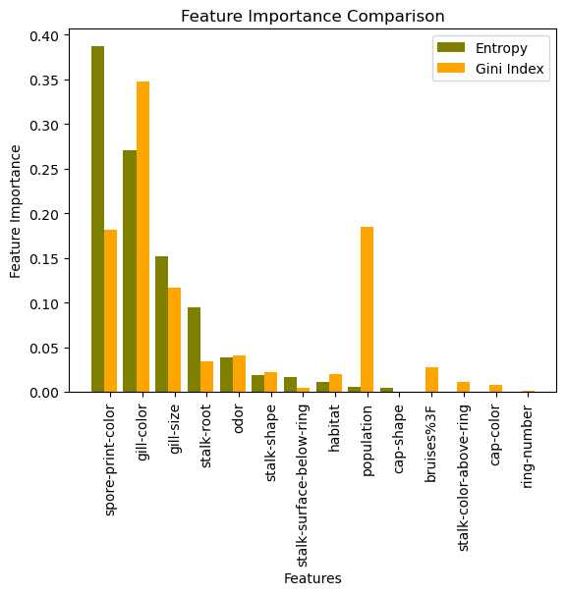
Milestone3.ipynb
visualizations.ipynb
# Comparison in feature importance between decision criterion entropy and gini index
Python 3.10.9
Cell 8 of 14

Slide 9
Milestone3.ipynb
visualizations.ipynb
# Entropy Decision Tree
Python 3.10.9
Cell 9 of 14

Slide 10
Milestone3.ipynb
visualizations.ipynb
# Gini Index Decision Tree
Python 3.10.9
Cell 10 of 14

Slide 11
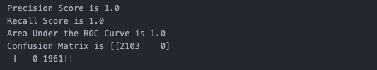
# imports - model metrics from sklearn.metrics import roc_curve, auc, confusion_matrix, precision_score, recall_score from sklearn.model_selection import cross_val_score, cross_validate print('Precision Score is', precision) print('Recall Score is', recall) print('Area Under the ROC Curve is', log_auc) print('Confusion Matrix is', conf_matrix) # 2103 classified correctly as edible # 1961 classified correctly as poisonous
Milestone3.ipynb
visualizations.ipynb
Python 3.10.9
Cell 11 of 14

Slide 12
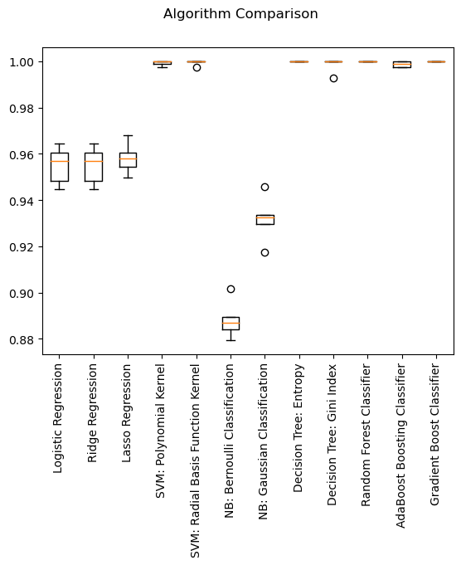
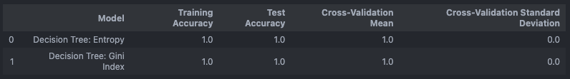
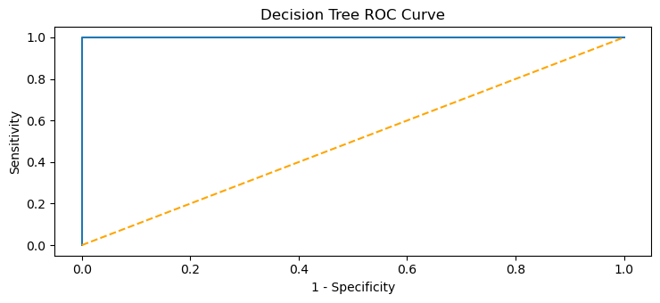
Milestone3.ipynb
visualizations.ipynb
# Comparing Machine Learning Algorithm Accuracy
Python 3.10.9
Cell 12 of 14

Slide 13
Milestone3.ipynb
visualizations.ipynb
print(conclusion)
...
Both the entropy and gini index criterion trees successfully predict the classification of edible and poisonous mushrooms even though their decision tree branches split differently and put more importance on different features of interest.
Spore print color and gill color have the strongest predictive power in whether a mushroom is edible or poisonous in comparison to the various other features with much weaker predictive power.
Python 3.10.9
Cell 13 of 14

Slide 14
quit()

